Slide 1
CMSC201
Computer Science I for Majors
Lecture 09 – Strings

Slide 2
Last Class We Covered
Lists and what they are used for
  Getting the length of a list
  Operations like append() and remove()
  Iterating over a list using a while loop
  Indexing
Membership “in” operator
Methods vs Functions

Slide 3
Any Questions from Last Time?

Slide 4
Today’s Objectives
To better understand the string data type
  Learn how they are represented
  Learn about and use some of their built-in methods
    Slicing and concatenation
    Escape sequences
    lower() and upper()
    strip() and whitespace
    split() and join()

Slide 5
Strings

Slide 6

The String Data Type
Text is represented in programs by
the string data type
A string is a sequence of characters
enclosed within double quotes (")
or single quotes (')
  Sometimes called
  quotation marks or
  apostrophes

Slide 7
Getting Strings as Input
Using input() automatically gets a string
  >>> firstName = input("Please enter your name: ")
  Please enter your name: Shakira
  >>> type(firstName)
  <class 'str'>
  >>> print(firstName, firstName)
  Shakira Shakira

Slide 8
Accessing Individual Characters
We can access the individual characters
in a string through indexing
  Characters are the letters, numbers, spaces, and symbols that make up a string
The characters in a string are numbered starting from the left, beginning with 0
  Just like in lists!

Slide 9
Syntax of Accessing Characters
The general form is
  strName[expression]
Where strName is the name of the string variable and expression determines which character is selected from the string

Slide 10
Example String
0 | 1 | 2 | 3 | 4 | 5 | 6 | 7 | 8
H | e | l | l | o |  | B | o | b
>>> greet = "Hello Bob"
>>> greet[0]
'H'
>>> print(greet[0], greet[2], greet[4])
H l o
>>> x = 8
>>> print(greet[x - 2])
B

Slide 11
Example String
0 | 1 | 2 | 3 | 4 | 5 | 6 | 7 | 8
H | e | l | l | o |  | B | o | b
In a string of n characters, the last
character is at position n-1 since we
start counting with 0
So how can we access the last letter, regardless of the string’s length?
  greet[ len(greet) – 1 ]

Slide 12
Changing String Case
Python has many, many ways to interact with strings, and we will cover them in detail soon
For now, here are two very useful methods:
  s.lower() – copy of s in all lowercase letters
  s.upper() – copy of s in all uppercase letters
Why would we need to use these?
  Remember, Python is case-sensitive!

Slide 13
Concatenation

Slide 14
Forming New Strings - Concatenation
We can put two or more strings together to form a longer string
Concatenation “glues” two strings together
  >>> "Peanut Butter" + "Jelly"
  'Peanut ButterJelly'
  >>> "Peanut Butter" + " & " + "Jelly"
  'Peanut Butter & Jelly'

Slide 15
Rules of Concatenation
Concatenation does not automatically include spaces between the strings
  >>> "Smash" + "together"
  'Smashtogether'
Concatenation can only be done with strings!
  So how would we concatenate an integer?
  >>> "CMSC " + str(201)
  'CMSC 201'

Slide 16
Common Use for Concatenation
input() only accepts a single string
  Can’t use commas like we do with print()
In order to create a single string for input(), you must use concatenation
  classNum = 201
  grade = input("Grade in " + str(classNum) + "? ")

Slide 17
Sentinels and Concatenation
To take full advantage of sentinel constants,
use them in the input prompts as well
Instead of:
  name = input("Name, X to quit: ")
Concatenate to include the sentinel constant
  name = input("Name, " + EXIT + " to quit: ")

Slide 18
Sentinels, input(), and Concatenation
We can even get really lazy, and create the message string before using it in input()
SENTINEL = -1
def main():
msg = "Enter a grade, or '" + str(SENTINEL) + "' to quit: "
grade = int(input(msg))
while grade != SENTINEL:
print("Congrats on getting a", grade, "in the class!")
grade = int(input(msg))
main()
don’t forget to cast to string if needed

Slide 19
Substrings and Slicing

Slide 20
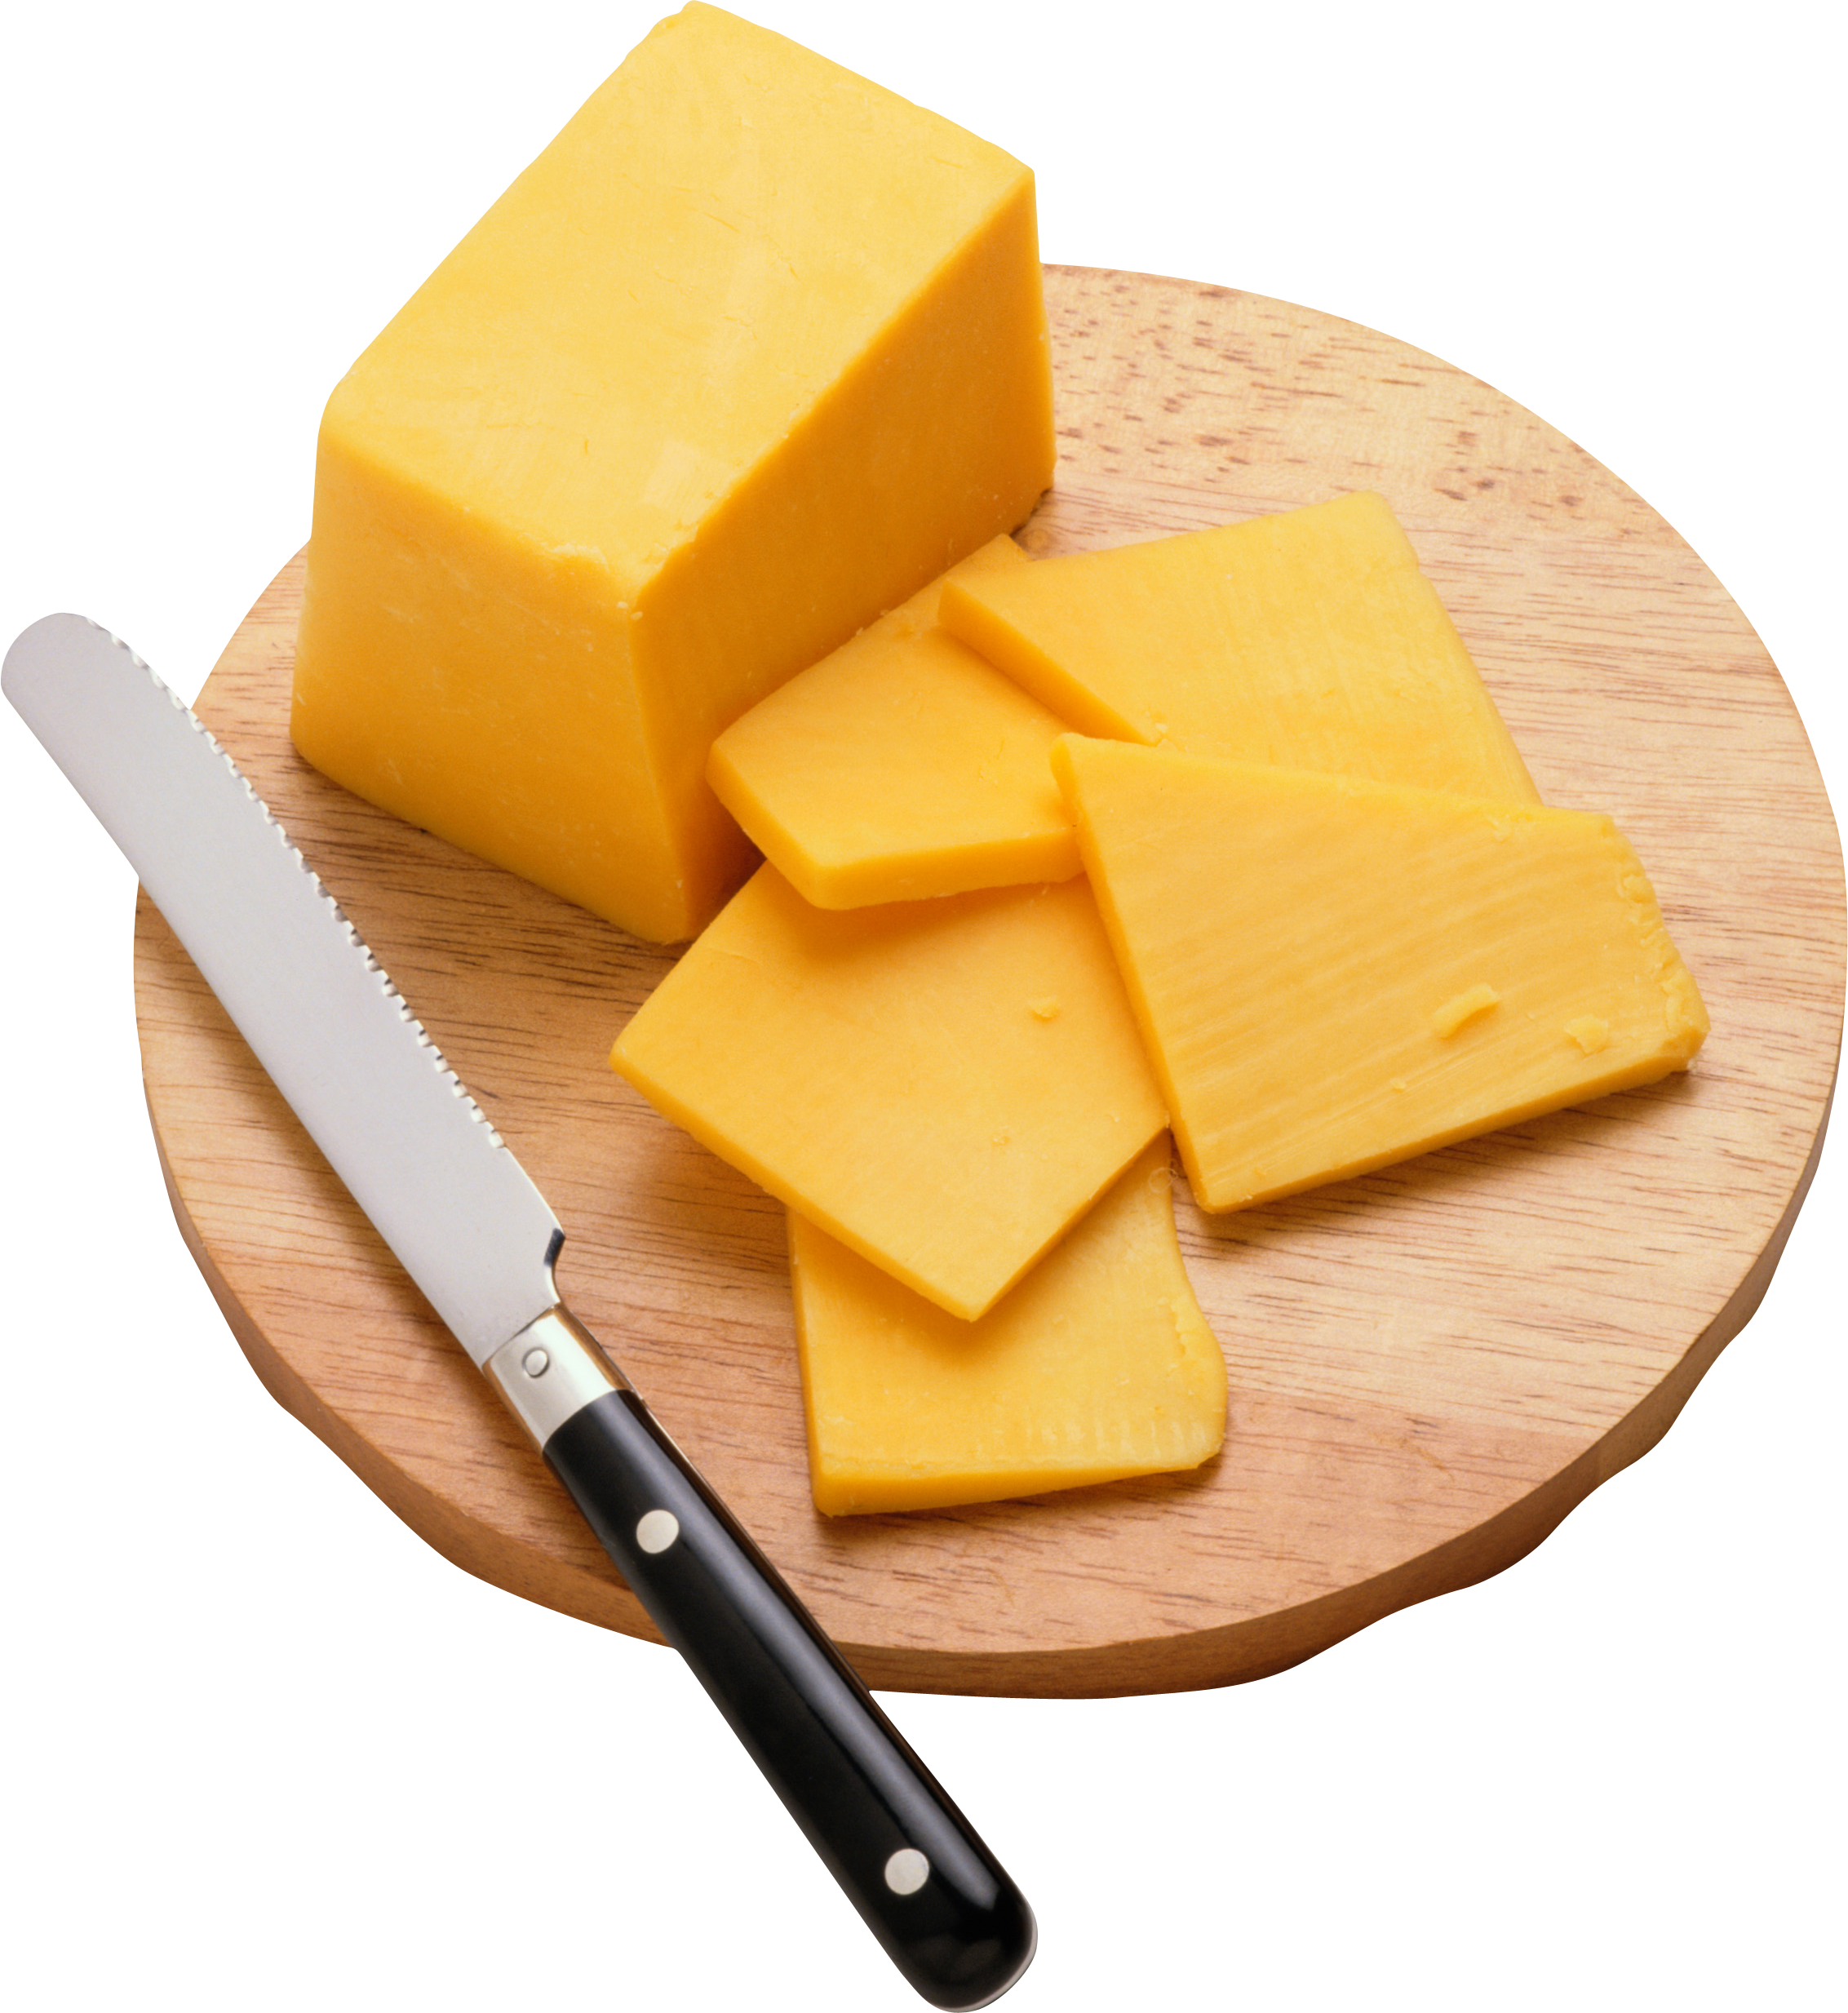
Substrings
Indexing only returns a single character
from the entire string
We can access a substring using
a process called slicing

Slide 21
Slicing Syntax
The general form is
  strName[start:end]
start and end must evaluate to integers
  The substring begins at index start
  The substring ends before index end
    The letter at index end is not included

Slide 22
Slicing Examples
0 | 1 | 2 | 3 | 4 | 5 | 6 | 7 | 8
H | e | l | l | o |  | B | o | b
>>> greet[0:2]
'He'
>>> greet[7:9]
'ob'
>>> greet[:5]
'Hello'
>>> greet[1:]
'ello Bob'
>>> greet[:]
'Hello Bob'

Slide 23
Specifics of Slicing
If start or end are missing, then the start or end of the string is used instead
The index of end must come after
the index of start
  What would the substring greet[1:1] be?
  ''
  An empty string!

Slide 24
String Operations in Python
Operator | Meaning
+
stringVar[#]
stringVar[#:#]
len(stringVar)
Concatenation
Indexing
Slicing
Length
All of this also applies to lists!
  Two lists can be concatenated together
  A sublist can be sliced from another list

Slide 25
Escape Sequences

Slide 26
Special Characters
Just like Python has special keywords…
  and, while, True, etc.
It also has special characters
  Single quote ('), double quote ("), etc.
How can we print out a " as part of a string?
  print("And I shouted "hey!" at him.")
  What’s going to happen here?
  SyntaxError: EOL while scanning string literal

Slide 27
Backslash: Escape Sequences
The backslash character (\) is used to “escape” a special character in Python
  Tells Python not to treat it as special
The backslash character goes in front of the character we want to “escape”
  >>> print("And I shouted \"hey!\"")
  And I shouted "hey!"

Slide 28
Common Escape Sequences
Escape Sequence | Purpose
Escaping special characters
\' | Print a single quote
\" | Print a double quote
\\ | Print a backslash
Inserting a special character
\t | Print a tab
\n | Print a new line (“enter”)

Slide 29
Escape Sequences Example
special1 = "I\tlove tabs."
print(special1)
I love tabs.
special2 = "It's time to\nsplit!"
print(special2)
It's time to
split!
special3 = "Keep \\ em \\ separated"
print(special3)
Keep \ em \ separated
\t adds a tab
\n adds a newline
\\ adds a single backslash

Slide 30
Escape Sequences Example
Note that there are no spaces around the escape sequences, but they work fine. What would happen if we added a space after \t or \n here?
special1 = "I\tlove tabs."
print(special1)
I love tabs.
special2 = "It's time to\nsplit!"
print(special2)
It's time to
split!
special3 = "Keep \\ em \\ separated"
print(special3)
Keep \ em \ separated

Slide 31
How Python Handles Escape Sequences
Escape sequences look like two characters to us
Python treats them as a single character
  example1 = "dog\n"
  example2 = "\tcat"
0 | 1 | 2 | 3
d | o | g | \n
0 | 1 | 2 | 3
\t | c | a | t

Slide 32
The “end” of print()
We’ve mentioned the use of end="" within a print() in a few of the homeworks
  By default, print() uses \n as its ending
We can use end= to change this
  print("No newlines", end="")
  print("More space please", end="\n\n")
  print("Smile!", end=" :)\n")
  Remember to put a \n in if you still want one!

Slide 33
Whitespace

Slide 34


Whitespace
Whitespace is any “blank” character, that represents space between other characters
For example: tabs, newlines, and spaces
"\t" "\n" " "
Whitespace can cause similar
strings to not be equivalent
  >>> "dog" == " dog"
  False

Slide 35
Removing Whitespace
To remove all whitespace from the start and end of a string, we can use a method called strip()
  spacedOut = spacedOut.strip()
\t |  | c | a | t |  | s | \n
spacedOut

Slide 36
Removing Whitespace
To remove all whitespace from the start and end of a string, we can use a method called strip()
  spacedOut = spacedOut.strip()
\t |  | c | a | t |  | s | \n
spacedOut

Slide 37
Removing Whitespace
To remove all whitespace from the start and end of a string, we can use a method called strip()
  spacedOut = spacedOut.strip()
notice that strip() does not remove “interior” spacing
\t |  | c | a | t |  | s | \n
spacedOut

Slide 38
String Splitting

Slide 39
String Splitting
We can also break a string into pieces
  Stored as a list of strings
The method is called split(), and it has two ways it can be used:
  Break the string up by its whitespace
  Break the string up by a specific character

Slide 40
Splitting by Whitespace
Calling split() with nothing inside the parentheses will split on all whitespace
  Even the “interior” whitespace
>>> line = "hello world \n"
>>> line.split()
['hello', 'world']
>>> love = "\t\nI love\t\t\nwhitespace\n "
>>> love.split()
['I', 'love', 'whitespace']

Slide 41
Splitting by Specific Character
Calling split() with a string in it, we can remove a specific character (or more than one)
>>> under = "once_twice_thrice"
>>> under.split("_")
['once', 'twice', 'thrice']
>>> double = "hello how ill are all of your llamas?"
>>> double.split("ll")
['he', 'o how i', ' are a', ' of your ', 'amas?']
these character(s) that we want to remove are called the delimiter

Slide 42
Splitting by Specific Character
Calling split() with a string in it, we can remove a specific character (or more than one)
>>> under = "once_twice_thrice"
>>> under.split("_")
['once', 'twice', 'thrice']
>>> double = "hello how ill are all of your llamas?"
>>> double.split("ll")
['he', 'o how i', ' are a', ' of your ', 'amas?']
these character(s) that we want to remove are called the delimiter
notice that it didn’t remove the whitespace

Slide 43
Practice: Splitting
Use split() to solve the following problems
Split this string on its whitespace:
daft = "around \t the \nworld"
Split this string on the double t’s (tt):
adorable = "nutty otters making lattes"

Slide 44
Practice: Splitting
Use split() to solve the following problems
Split this string on its whitespace:
daft = "around \t the \nworld"
daft.split()
Split this string on the double t’s (tt):
adorable = "nutty otters making lattes"
adorable.split("tt")

Slide 45
Looping over Split Strings
Splitting a string creates a list of smaller strings
Using a while loop and this list, we can iterate over each individual word (or token)
  words = sentence.split()
  index = 0
  while index < len(words):
  print(words[index])
  index += 1

Slide 46
Example: Looping over Split Strings
lyrics = "stars in their eyes"
lyricWords = lyrics.split()
  index = 0
  while index < len(lyricWords):
  print("*" + lyricWords[index] + "*")
  index += 1
*stars*
*in*
*their*
*eyes*
what does this line of code do?
append a “*” to the front and end of each list element, then print

Slide 47
String Joining

Slide 48
Joining Strings
We can also join a list of strings back together!
  The syntax looks different from split()
  And it only works on a list of strings
  "X".join(list_of_strings)
method name
the list of strings we want to join together
the delimiter (what we will use to join the strings)

Slide 49
Example: Joining Strings
>>> names = ['Alice', 'Bob', 'Carl', 'Dana', 'Eve']
>>> "_".join(names)
'Alice_Bob_Carl_Dana_Eve'
We can also use more than one character as our delimiter if we want
>>> " <3 ".join(names)
'Alice <3 Bob <3 Carl <3 Dana <3 Eve'

Slide 50
split() vs join()
The split() method
  Takes in a single string
  Creates a list of strings
  Splits on given character(s), or on all whitespace
The join() method
  Takes in a list of strings
  Returns a single string
  Joins together with a user-chosen delimiter

Slide 51
String and List Operations
Many of the operations we’ve learned are possible to use on strings and on lists
Operation | Strings | Lists
Concatenation +
Indexing [ ]
Slicing [ : ]
.lower() / .upper()
.append() / .remove()
len()
✓
✓
✓
✓
✓
✓
✓
✗
✗
✓
✓
✓

Slide 52
Daily Shortcut
CTRL+Z
  “Minimizes” the emacs window
fg
  Used in the terminal, and “maximizes” it again
Useful when coding and testing
  Save and minimize, run code, maximize it to edit
  Keeps the kill ring, where you are in the file, etc.

Slide 53
Announcements
HW 4 is out on Blackboard now
  Due by Friday (October 5th) at 8:59:59 PM
Lab 5 is out on Blackboard as well.
  Due Thurs (October 4th) at 8:59:59PM
  Do this before you take the midterm!
Midterm is in class, October 3rd and 4th
  Survey #1 will be released this week as well

Slide 54
Image Sources
Sewing thread (adapted from):
  https://pixabay.com/p-936467
Cheese slices:
  http://pngimg.com/download/4276
Space dog (adapted from):
  https://commons.wikimedia.org/wiki/File:Space_dog_illustration.png

